Slide 1
Maximum-Flow Problem
Yao zhao

Slide 2

Ford-Fulkerson Algorithm Edmonds-Karp Algorithm Dinic Algorithm Example
outline

Slide 3
Ford-Fulkerson Review

Slide 5
Edmonds-Karp (Shortest augmenting path)
Always find the shortest augmenting path
Complexity improved to O(|V||E|²)
BFS(G_{f}) and can find a path P from s to t

Slide 6
Edmonds-Karp process(1)
BFS first time
10
10
1
2
10
1
2
10
10
3
10
10
3
10
s
t
s
t
10
10
30
5
20
30
5
20
4
4
20
20

Slide 7
Edmonds-Karp process(2)
BFS second time
10
10
1
2
10
1
2
10
3
10
3
10
10
10
t
s
t
s
20
10
20
10
10
5
20
10
5
20
4
4
20
20

Slide 8
Edmonds-Karp process(3)
10
1
2
10
10
Stop
Max flow is 30
10
3
s
t
10
30
5
20
4
20

Slide 9
Every time BFS starts from s to t -- a waste of time?

Slide 10
Dinic
Further optimized Edmonds-Karp algorithm
DFS is used to find augmented paths ( In a hierarchical network, DFS always find a shortest path )

Slide 11
Dinic process(1)
Initial residual graph
1、construct residual graph and hierarchical network， If the sink is not in the hierarchical network, stop; Otherwise, proceed to step 2.
10
10
1
2
10
1
2
10
3
10
10
10
s
t
s
10
3
t
10
10
30
5
20
30
20
4
5
4
20
20
0 1 2 3

Slide 12
Dinic process(2)
2、 Using DFS algorithm, proceed from the vertex of layer i to the vertex of layer i +1, if reach the sink point t, means find an augmented path. If cannot reach t, Go back to step 1 （P.11）
10
10
1
2
1
2
10
10
10
10
s
3
10
s
3
10
t
t
10
10
30
20
30
20
4
5
4
5
20
20
0 1 2 3
0 1 2 3

Slide 13
Dinic process(3)
3、Go back and update the capacity value. When return to layer I, and you find that you have another edge can reach layer I + 1. If the path reach t, you find another augmented path.
10
10
1
2
1
2
10
10
10
10
s
3
10
s
3
10
t
t
10
10
10
0
10
0
4
5
4
5
0
0
0 1 2 3
0 1 2 3
Find another path from the layer 1.
DFS return here，update the capacity of edge.

Slide 14
Dinic process(4)
4、 Step back, update the capacity value, and if no new augmented path can be found until step back to point s, the DFS process ends. Go back to step 2 (P.12).
In step 2: can‘t reach t, go back to step 1 (P.11), then stop.
10
10
1
2
1
2
10
10
10
10
3
s
0
s
3
t
t
0
0
0
4
5
0
0 1 2 3
0 1 2 3
The sink point doesn’t join to the new hierarchical network, stop.
Construct a new hierarchical network

Slide 15
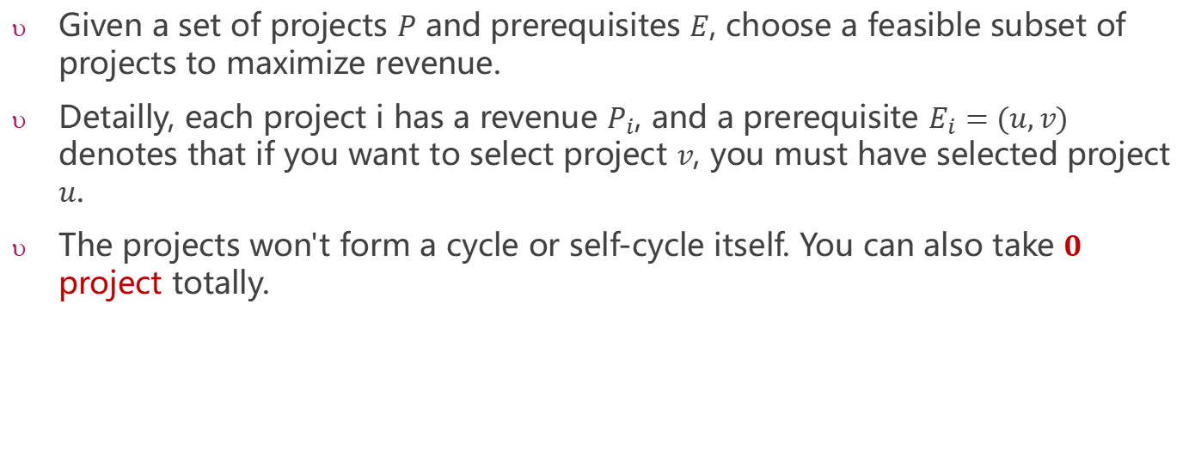
Example: Project Selection
Given a set of projects $P$ and prerequisites $E$, choose a feasible subset of projects to maximize revenue.
Detailly, each project i has a revenue $P_{i}$, and a prerequisite $E_{i}=(u,v)$ denotes that if you want to select project $v$, you must have selected project $u$.
The projects won't form a cycle or self-cycle itself. You can also take $0$ project totally.

Slide 16



Sample Input
4 4
3 -2 1 1
1 2
1 3
2 4
3 4
$n, m$
-2
1
Project subset | revenue
{} | 0
{1} | 3
{1,2} | 1
{1,3} | 4
{1,2,3} | 2
{1,2,3,4} | 3
2
4
$$\text{the} \text{revenue} \text{of} n \text{project}\text{s}$$
1
3
$m$ prerequisites
maximum
3
1
Output:
4

Slide 17
Analysis
The critical point is constructing a graph and converting it to a familiar question for you.

Slide 18


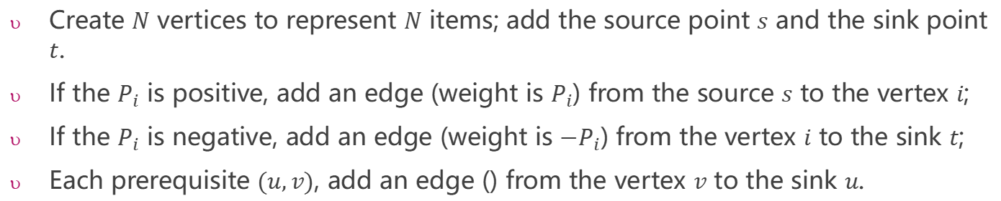
How to construct a new graph $G’$
Create $N$ vertices to represent $N$ items; add the source point $s$ and the sink point $t$.
If the $P_{i}$ is positive, add an edge (weight is $P_{i}$) from the source $s$ to the vertex $i$;
If the $P_{i}$ is negative, add an edge (weight is ${−P}_{i}$) from the vertex $i$ to the sink $t$;
Each prerequisite $(u,v)$, add an edge () from the vertex $v$ to the sink $u$.
4 4
3 -2 1 1
1 2
1 3
2 4
3 4
$n, m$
$$\text{the} \text{revenue} \text{of} n \text{project}\text{s}$$
4
1
∞
-2
1
2
∞
4
2
1
s
3
2
t
$m$ prerequisites
∞
∞
1
3
3
1
3
1
$$G$$
$$G’$$

Slide 19
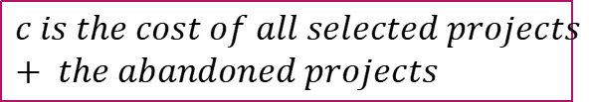
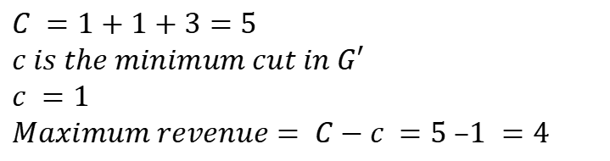
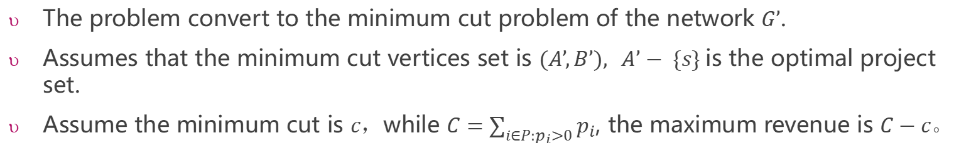
Analysis
The problem convert to the minimum cut problem of the network $G’$.
Assumes that the minimum cut vertices set is $(A’,B’), A’− \{s\}$is the optimal project set.
Assume the minimum cut is $c$，while $C=\sum_{i∈P:p_{i}>0}{p_{i}}$, the maximum revenue is $C−c$。
4
$$C is the sum of all revenue>0 projects.$$
1
∞
∞
$$C =1+1+3=5$$
$$c is the minimum cut in G′$$
$$c =1$$
$$Maximum revenue= C−c =5 –1 =4$$
1
2
s
3
2
t
∞
∞
3
1
$$c is the cost of all selected projects + the abandoned projects$$
$$G’$$

Slide 20
How to output the subset of projects to maximize revenue?
After calculating the maximum flow, the residual graph maybe looks like the following:
0
Initial flags of all node to 0
0
4
4
1
1
0
∞
1
0
∞
1
∞
∞
1
0
1
1
1
1
3
2
t
s
3
2
t
s
1
1
∞
∞
0
Start DFS from the node s, if a node can be reachable ,change the flag from 0 to 1.
∞
∞
0
3
1
3
1
0
1
$$G’$$
$$G’$$
The optional subset of projects: {3,1}

